Slide 1
FY23 Condensed Application Exemplar
Department of Education & Early Development
Susan Forbes, School Improvement Specialist
education.alaska.gov
April 13, 2022

Slide 2
Agenda
Purpose
School Data, Situational Analysis, and Plan
Prioritized Goals Table
Intervention/Activity Estimated Costs Table
    Budget Narrative
Questions

Slide 3
Purpose of the Exemplar
The FY23 Condensed Application Exemplar was created for two purposes:
1) To assist designated schools in understanding the requirements for completing the condensed application.
2) To provide designated schools with a model of how to connect site-specific data and needs to school plans for improvement, including goals, interventions, and activities.

Slide 4
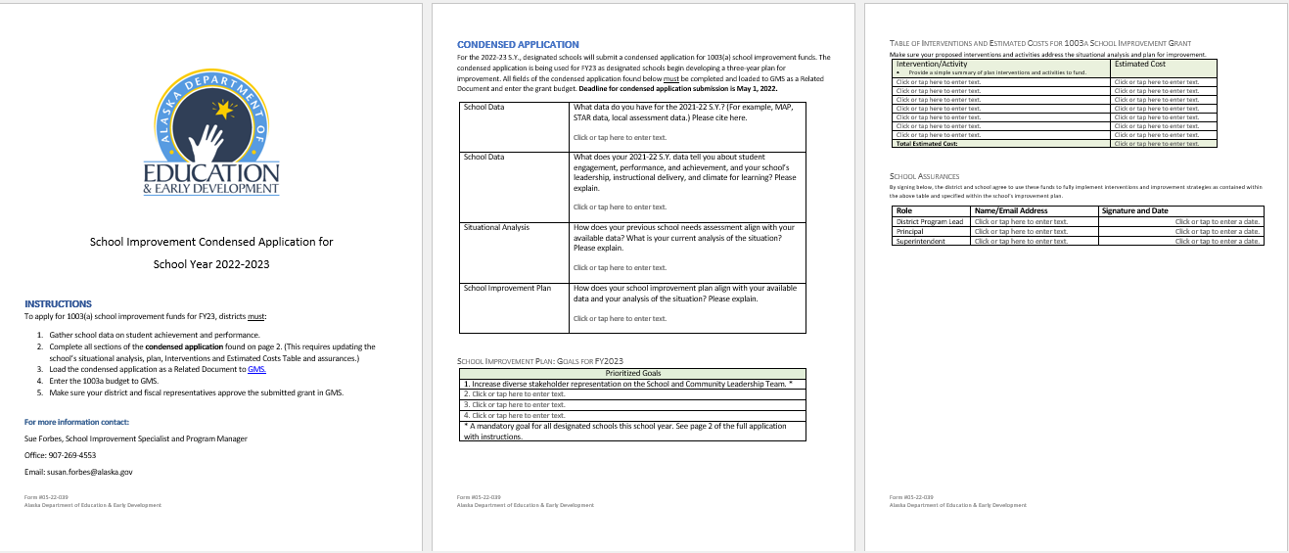
Condensed Application Requirements
-Intervention/Activity Cost Table
-Data
-Needs
-Plan
-Assurances
-Goals

Slide 5
School Selected for Exemplar Portrayal
For the FY23 Condensed Application Exemplar, a small school with a student population of fifty students in grades K – 12 was selected for fictious portrayal.
The situational analysis (needs assessment), goals, and interventions found in this exemplar are based on this fictious school and fabricated data.
Any similarities to an existing school are purely coincidental.

Slide 6
Where to find the Condensed Application and the Condensed Application Exemplar
https://education.alaska.gov
Excellence and Education
School Improvement
FY23 Condensed Application
FY23 Condensed Application Exemplar

Slide 7
Box #1 - School Data
What data do you have for the 2021-22 S.Y.? (For example, MAP, STAR data, local assessment data.) Please cite here.
2021-22 MAP achievement and growth data
2021 PEAKS scores
SY 2021-22 student attendance and referral records
SY 2021-22 family engagement event attendance records

Slide 8
Box #2 - School Data
What does your 2021-22 S.Y. data tell you about student engagement, performance, and achievement, and your school’s leadership, instructional delivery, and climate for learning? Please explain.
Achievement percentiles for all students in grade K-6 (30 out of 30 students) fall in the lowest 10%*.
Achievement percentiles for all students in grade 7 – 12 (20 out of 20 students) fall in the lowest 50%*, with 18 out of 20 students in grades 7 – 12 ranked at or below the 25th percentile.
The two grade 7 -12 students who are achieving above 25% in ELA are also performing above 25% in Math.
Notes:
*compared to national grade level norms,

Slide 9
School Data (continued)
MAP Growth data for students in grade K-6 in ELA and Math show 30 out of 30 students did not meet growth expectations for their grade.
MAP Growth data for students in grade 7-12 in ELA and Math show 8 out of 20 students met growth expectations for their grade.

Slide 10
School Data (continued)
Attendance data show an attendance rate of 95%, however this data is reflective of school board policy permitting an excused absence for cultural purposes.
Referral data show a referral rate average of one referral per quarter with no student suspensions in SY 2021-22.

Slide 11
School Data (continued)
Family engagement event participation data show 20 out of 25 families attended 50% or more of the school-sponsored family engagement activities, with 25 out of 25 families attending at least one event.
Staff retention for next school year is 100%. The staff average number of years of contracted service for the district is three years. All teachers are highly qualified. All paraprofessionals have Para Pro certification.

Slide 12
Box #3 - School Situational Analysis (Needs Assessment)
How does your previous school needs assessment align with your available data? What is your current analysis of the situation? Please explain.
Current Strengths:
Positive school climate and culture. Minimal behavioral issues.
Positive relationships between parents, community, and school.
Committed staff

Slide 13
School Situational Analysis (continued)
Current Needs:
Provide staff professional development in the Science of Reading.
Develop authentic, place-based, and standards-based lessons in partnership with the community.
Expand community involvement and engagement in the afterschool program and in school improvement planning

Slide 14
Box #4 - School Improvement Plan* Question
How does your school improvement plan align with your available data and your analysis of the situation? Please explain.
Our School Improvement Plan addresses the low achievement and growth of our students in reading by providing Science of Reading professional development to all teachers and paraprofessionals on staff.
Our plan builds on our current strength of community involvement by expanding our engagement events to the classroom and after-school programs.
Notes:
Although submitting a SIP is not required as part of the Condensed Application, it will need to be submitted to DEED if the district is selected for ESEA monitoring.
Updated plan should be stored on-site.

Slide 15
School Improvement Plan Response (continued)
Our plan includes partnering with the community to create native language and culture programs for after-school enrichment.
Standards-based classroom lessons grounded by place and local values will be developed in cooperation with the community.
Developed lessons will be tailored to support literacy across content areas.
An additional district staff member will be hired as an instructional coach to support literacy, monitor Science of Reading practice implementation, and lead the development of place-based, culturally relevant, cross-grade lessons.

Slide 16
Table #1 - Prioritized Goals
1. Increase diverse stakeholder representation on the School and Community Leadership Team.
2. 100% of teachers will be trained, fully implementing, and receiving feedback on their Science of Reading instructional practices on a weekly basis from September 2022 through May 2023.

Slide 17
Prioritized Goals (continued)
3. Each grade will produce, deliver, reflect, and refine at least one authentic, place-based, and standards-based “classroom” lesson per semester with lesson development done in partnership with the community and the district’s literacy coach.
4. 100% of students in grades K – 12 will meet or exceed ELA growth targets from Fall 2023 to Winter 2024 as measured by MAP benchmarking results.

Slide 18
Table #2 -Intervention/Activity Estimated Costs
Intervention/Activity 1 | Estimated Cost
Science of Reading Professional Development (Addresses Goal 2 and Goal 4) 4 staff registrations (2 certified and 2 classified) @ $350/unit cost = $1400 Airfare: 4 RT fares Rural Alaska – Anchorage on AK Air Transit@ $600/unit cost = $2,400 Lodging for 4 (2 double rooms) @ 5 nights @ $200 unit cost per night = $2,000 Food per diem ($60/day) X 5 days X 4 people = $1,200 Roundtrip Taxi Fare for Airport to Hotel and Return = $150 | $7,000

Slide 19
Intervention/Activity Estimated Costs Table
Intervention/Activity 2 | Estimated Cost
Certificated staff member to serve as district’s literacy coach providing teacher professional development and coaching on a weekly basis to each of four sites. (Addresses Goal 2, Goal 3, and Goal 4) School pays ¼ of $100,000 salary and benefits since the position is divided between 4 schools. | $25,000

Slide 20
Intervention/Activity Estimated Costs Table
Intervention/Activity 3 | Estimated Cost
Extended Learning Program: (Addresses Goal 4) 1 certified teacher at 4 hrs/wk + 1 certified teacher for 2 hrs/wk = 2 certified teachers @$50/hr for 6 hrs/wk serving 9 students ($300/wk X 35 weeks = $10,500) & 1 Para pro at $21.50/hr, 2 hrs/wk serving 3 students ($43/wk X 35 weeks= $1,505) Reading Interventions: 1 Para-Pro uses school phonics program for 2 students ($21.50/hr, 2 hrs/wk X 35 wks= $1,505) | $13,510

Slide 21
Intervention/Activity Estimated Costs Table
Intervention/Activity 4 | Estimated Cost
Family Engagement Events (Addresses Goal 1 and Goal 3) Two events per school year per grade band, K-3, 4-6, 7-9, and 10-12 (total of 8 events) showcasing student work samples from the authentic, place-based, and standards-based “classroom” lesson that was developed in partnership with the community and the district’s literacy coach. Community meal provided, each meal cost $300 * 8 = $2400. | $2400

Slide 22
Intervention/Activity Estimated Costs Table
Intervention/Activity 5 | Estimated Cost
School and Community Leadership Team (SCLT) Meeting Lunches (Addresses Goal 1) 8 SCLT Meetings, two Saturdays per month for four months from January – April, Lunch cost of $100 for each Saturday meeting, $100 * 8 = $800. | $800
Total Estimated Cost: | $48,710

Slide 23
Budget Narrative
Note specificity found in the exemplar

Slide 24

Questions

Slide 25
Webinar Dates – Every Other Wednesday at 4 pm
Our next webinars are
  April 27, May 11 and 25, and June 8 and 22
Link: School Improvement Webinar Series
  Meeting ID: 820 2485 0053
  Passcode: 545763
Earlier webinars are available on education.alaska.gov
  February 2 and 16, and March 2, 16, and 30
Today’s webinar will be posted ASAP

Slide 26
Contact Information
Brittnay Bailey
School Recognition and Support Administrator
Brittnay.Bailey@alaska.gov
(907) 269-6754
Susan McKenzie
IEE Director Susan.McKenzie@alaska.gov
(907) 500-8594
Susan Forbes
School Improvement Specialist
Susan.Forbes@alaska.gov
(907) 269-4553
Notes:
The presenter’s contact information should be presented on this slide in this format. We encourage including a photo of the presenter(s) to help personalize the presentation, especially if we are presenting virtually.

